Slide 1
Voter Registration
1

Slide 2
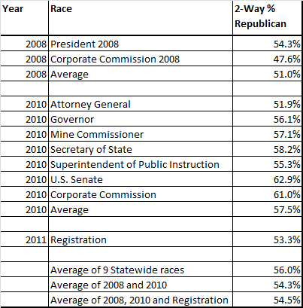

Slide 3
Correlation to Number of Seats Won
3

Slide 4
4

Slide 5
5

Slide 6
6

Slide 7
7

Slide 8
8

Slide 9
9

Slide 10
10

Slide 11
11

Slide 12
12

Slide 13
13

Slide 14
14

